Slide 1
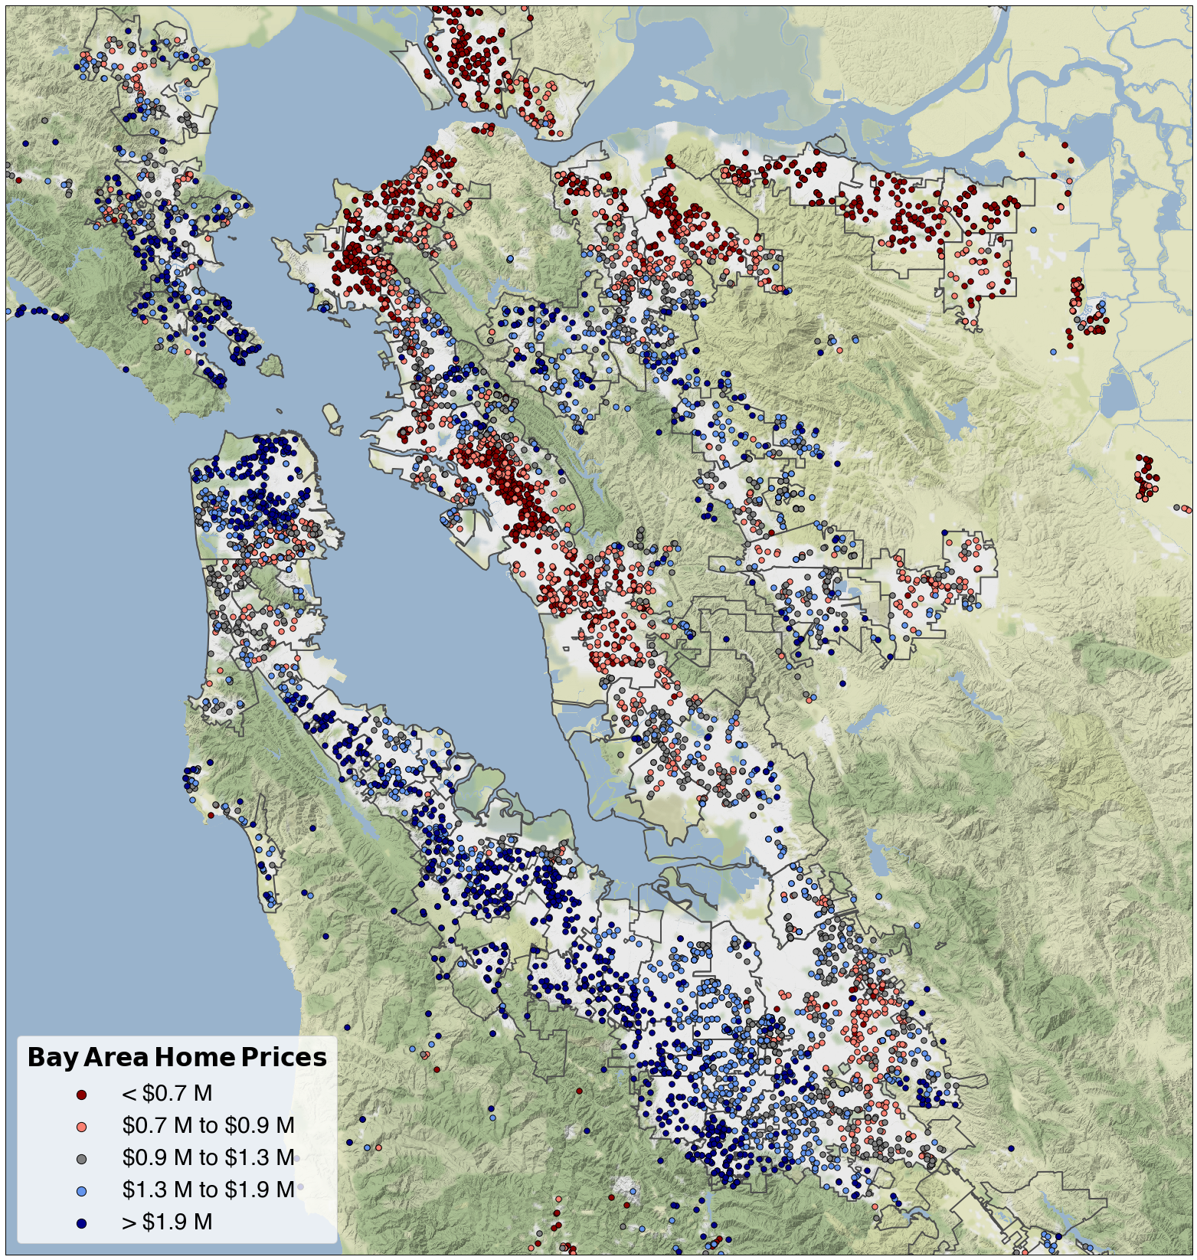
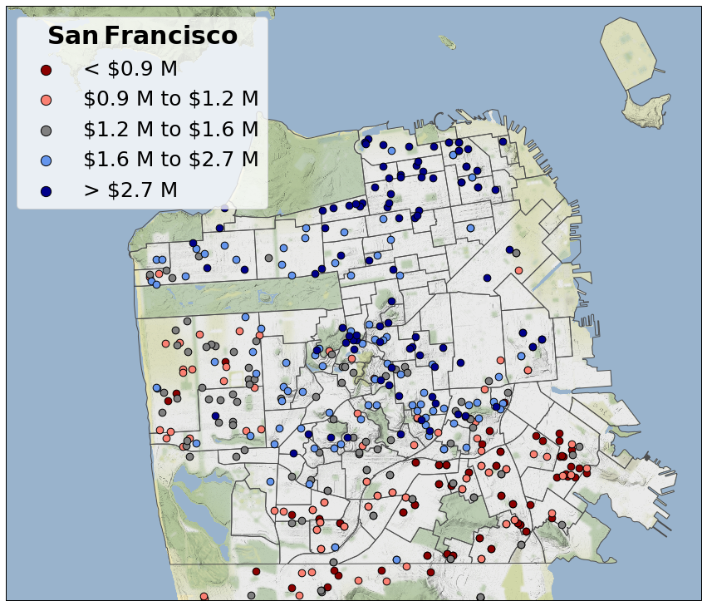
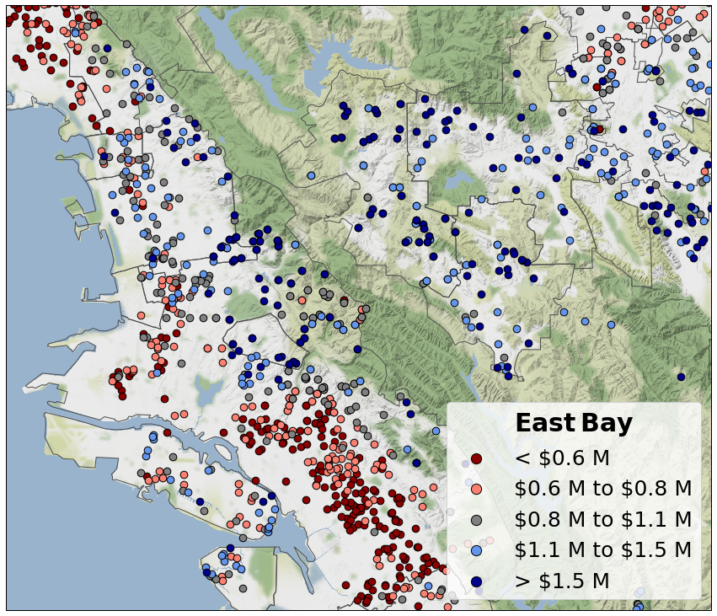
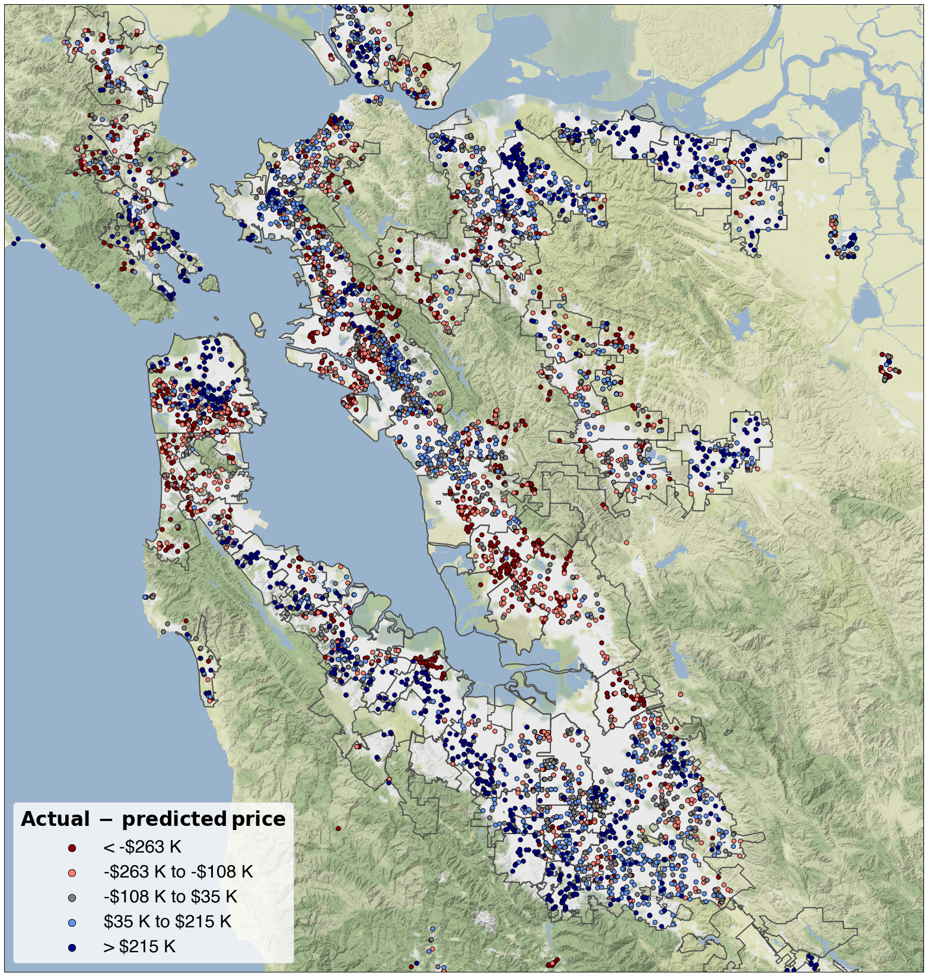
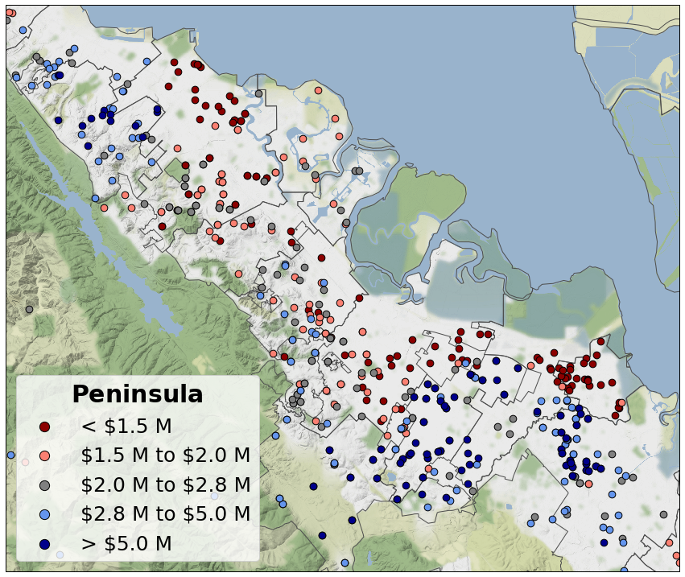
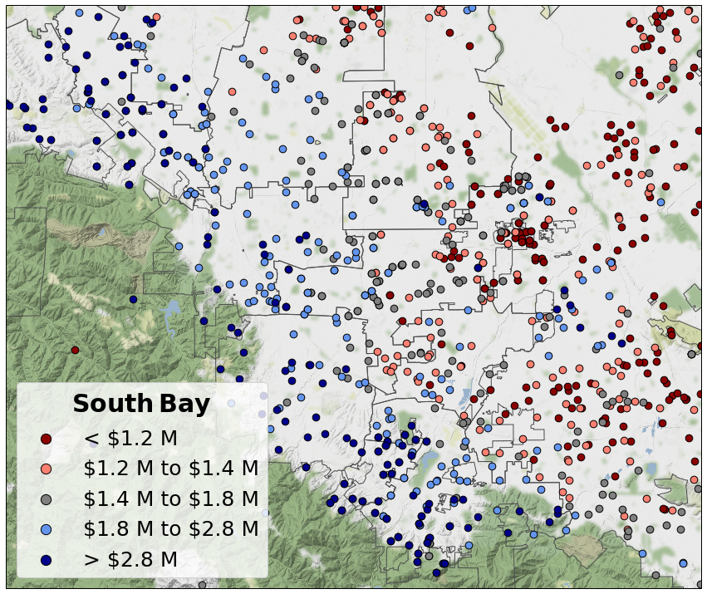
Concord
Vallejo
Vallejo
Novato
El Cerrito
Novato
Benicia
Benicia
Richmond
Walnut Creek
San Anselmo
Marina
Russian Hill
Orinda
Lafayette
San Anselmo
Albany
Pittsburg
Pittsburg
Hercules
Pacific Heights
Hercules
Martinez
Antioch
Martinez
Antioch
Berkeley
Richmond
Richmond
Richmond
MARIN
MARIN
Soma
Alamo
Walnut Creek
Walnut Creek
Emeryville
Moraga
Ashbury Heights
Mill Valley
Tiburon
Mill Valley
Tiburon
Mission
Piedmont
Berkeley
Berkeley
Orinda
Potrero Hill
Orinda
Sausalito
Bernal Heights
Oakland
Sausalito
Piedmont
Sunset
Noe Valley
Piedmont
EAST BAY
Danville
EAST BAY
Danville
Miraloma Park
Oakland
Bayview
Oakland
Alameda
San Ramon
San Ramon
San Francisco
San Francisco
Excelsior
Portola
Ingleside
San Leandro
San Leandro
Pleasanton
Pleasanton
Daly City
Daly City
Livermore
San Leandro
Livermore
San Bruno
San Bruno
Hayward
Burlingame
Mountain View
Hayward
Pacifica
Los Altos Hills
Pacifica
Burlingame
Los Altos
Burlingame
Santa Clara
San Mateo
San Mateo
Hillsborough
Foster City
Sunnyvale
Hillsborough
Hillsborough
San Mateo
Fremont
Fremont
PENINSULA
Menlo Park
Menlo Park
Redwood City
PENINSULA
Redwood City
San Jose
Half Moon Bay
Half Moon Bay
Cupertino
Palo Alto
Palo Alto
Woodside
Milpitas
Woodside
Milpitas
Belmont
Mountain View
Mountain View
San Carlos
Sunnyvale
Sunnyvale
Los Altos
Los Altos
Redwood City
Campbell
Santa Clara
Santa Clara
Saratoga
SOUTH BAY
SOUTH BAY
East Palo Alto
Cupertino
San Jose
Cupertino
San Jose
Menlo Park
Saratoga
Atherton
Saratoga
Palo Alto
Los Gatos
Los Gatos
Los Gatos
Novato
Novato
Vallejo
Vallejo
Benicia
Benicia
San Anselmo
San Anselmo
Pittsburg
Pittsburg
Hercules
Hercules
Antioch
Antioch
Richmond
Richmond
MARIN
Walnut Creek
MARIN
Walnut Creek
Tiburon
Tiburon
Mill Valley
Mill Valley
Berkeley
Berkeley
Orinda
Orinda
Sausalito
Piedmont
Sausalito
Piedmont
Oakland
Danville
Oakland
Danville
EAST BAY
TRI-VALLEY
EAST BAY
TRI-VALLEY
San Francisco
San Francisco
San Ramon
San Ramon
San Leandro
San Leandro
Daly City
Daly City
Pleasanton
Pleasanton
San Bruno
San Bruno
Hayward
Hayward
Burlingame
Burlingame
Pacifica
Pacifica
San Mateo
San Mateo
Hillsborough
Hillsborough
PENINSULA
PENINSULA
Fremont
Fremont
Redwood City
Redwood City
Menlo Park
Menlo Park
Palo Alto
Milpitas
Milpitas
Palo Alto
Mountain View
Mountain View
SOUTH BAY
SOUTH BAY
Sunnyvale
Sunnyvale
Los Altos
Los Altos
Santa Clara
Santa Clara
San Jose
San Jose
Cupertino
Cupertino
Saratoga
Saratoga
Los Gatos
Los Gatos
Pescadero
Pescadero

Slide 2




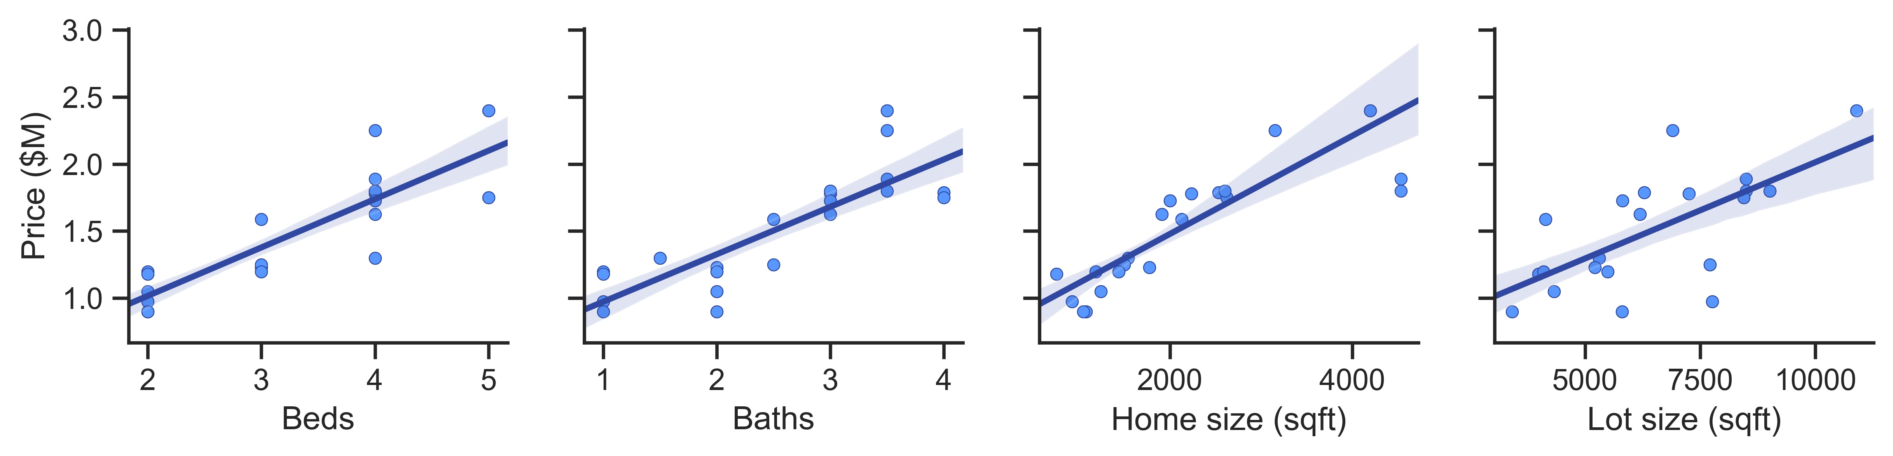
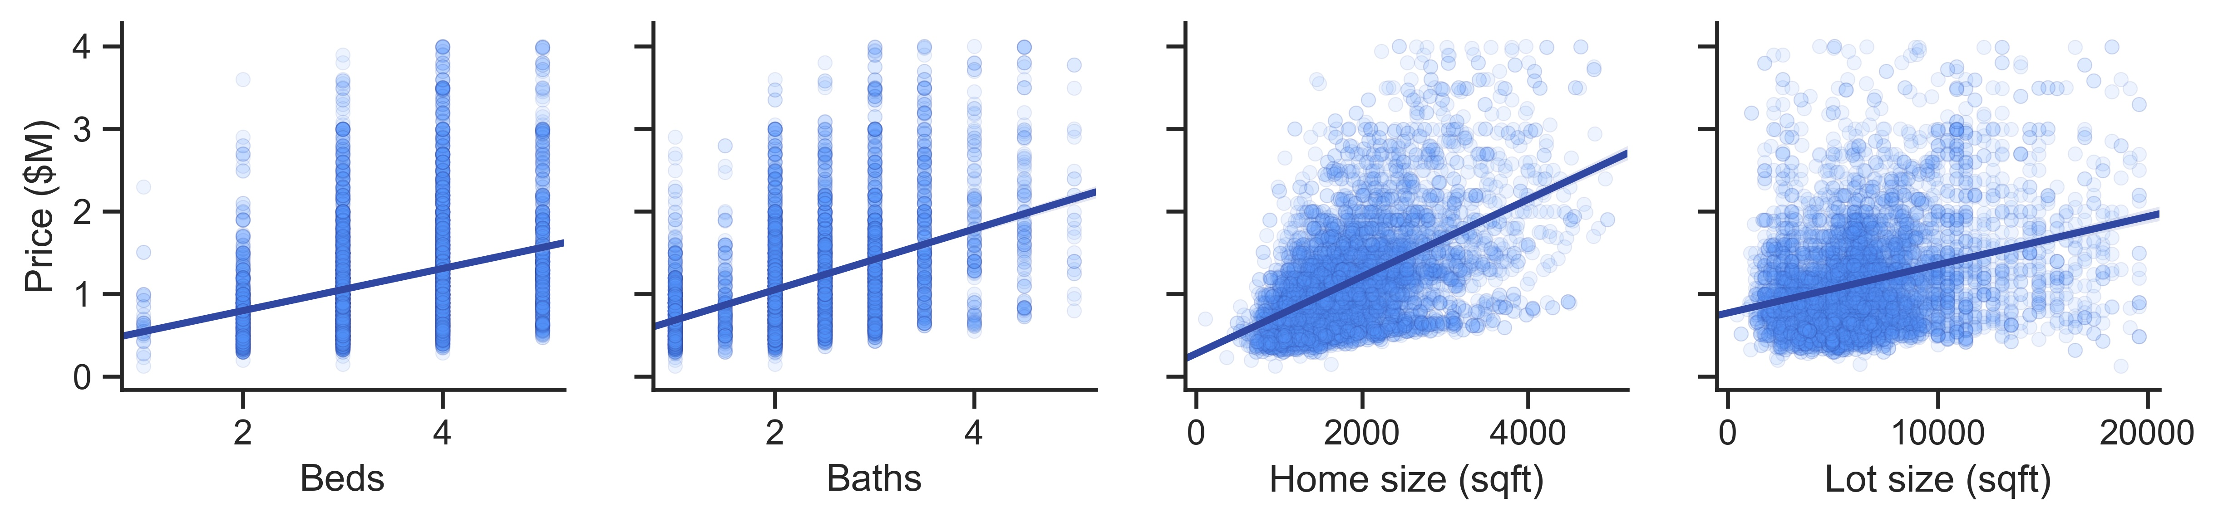
Scrape
Requests
BeautifulSoup
Clean
Re
Pandas
Visualize
Cartopy
Matplotlib
Seaborn
Analyze
Pandas
Numpy
Scikit-learn
Python 3.7, Anaconda 4.6

Slide 3
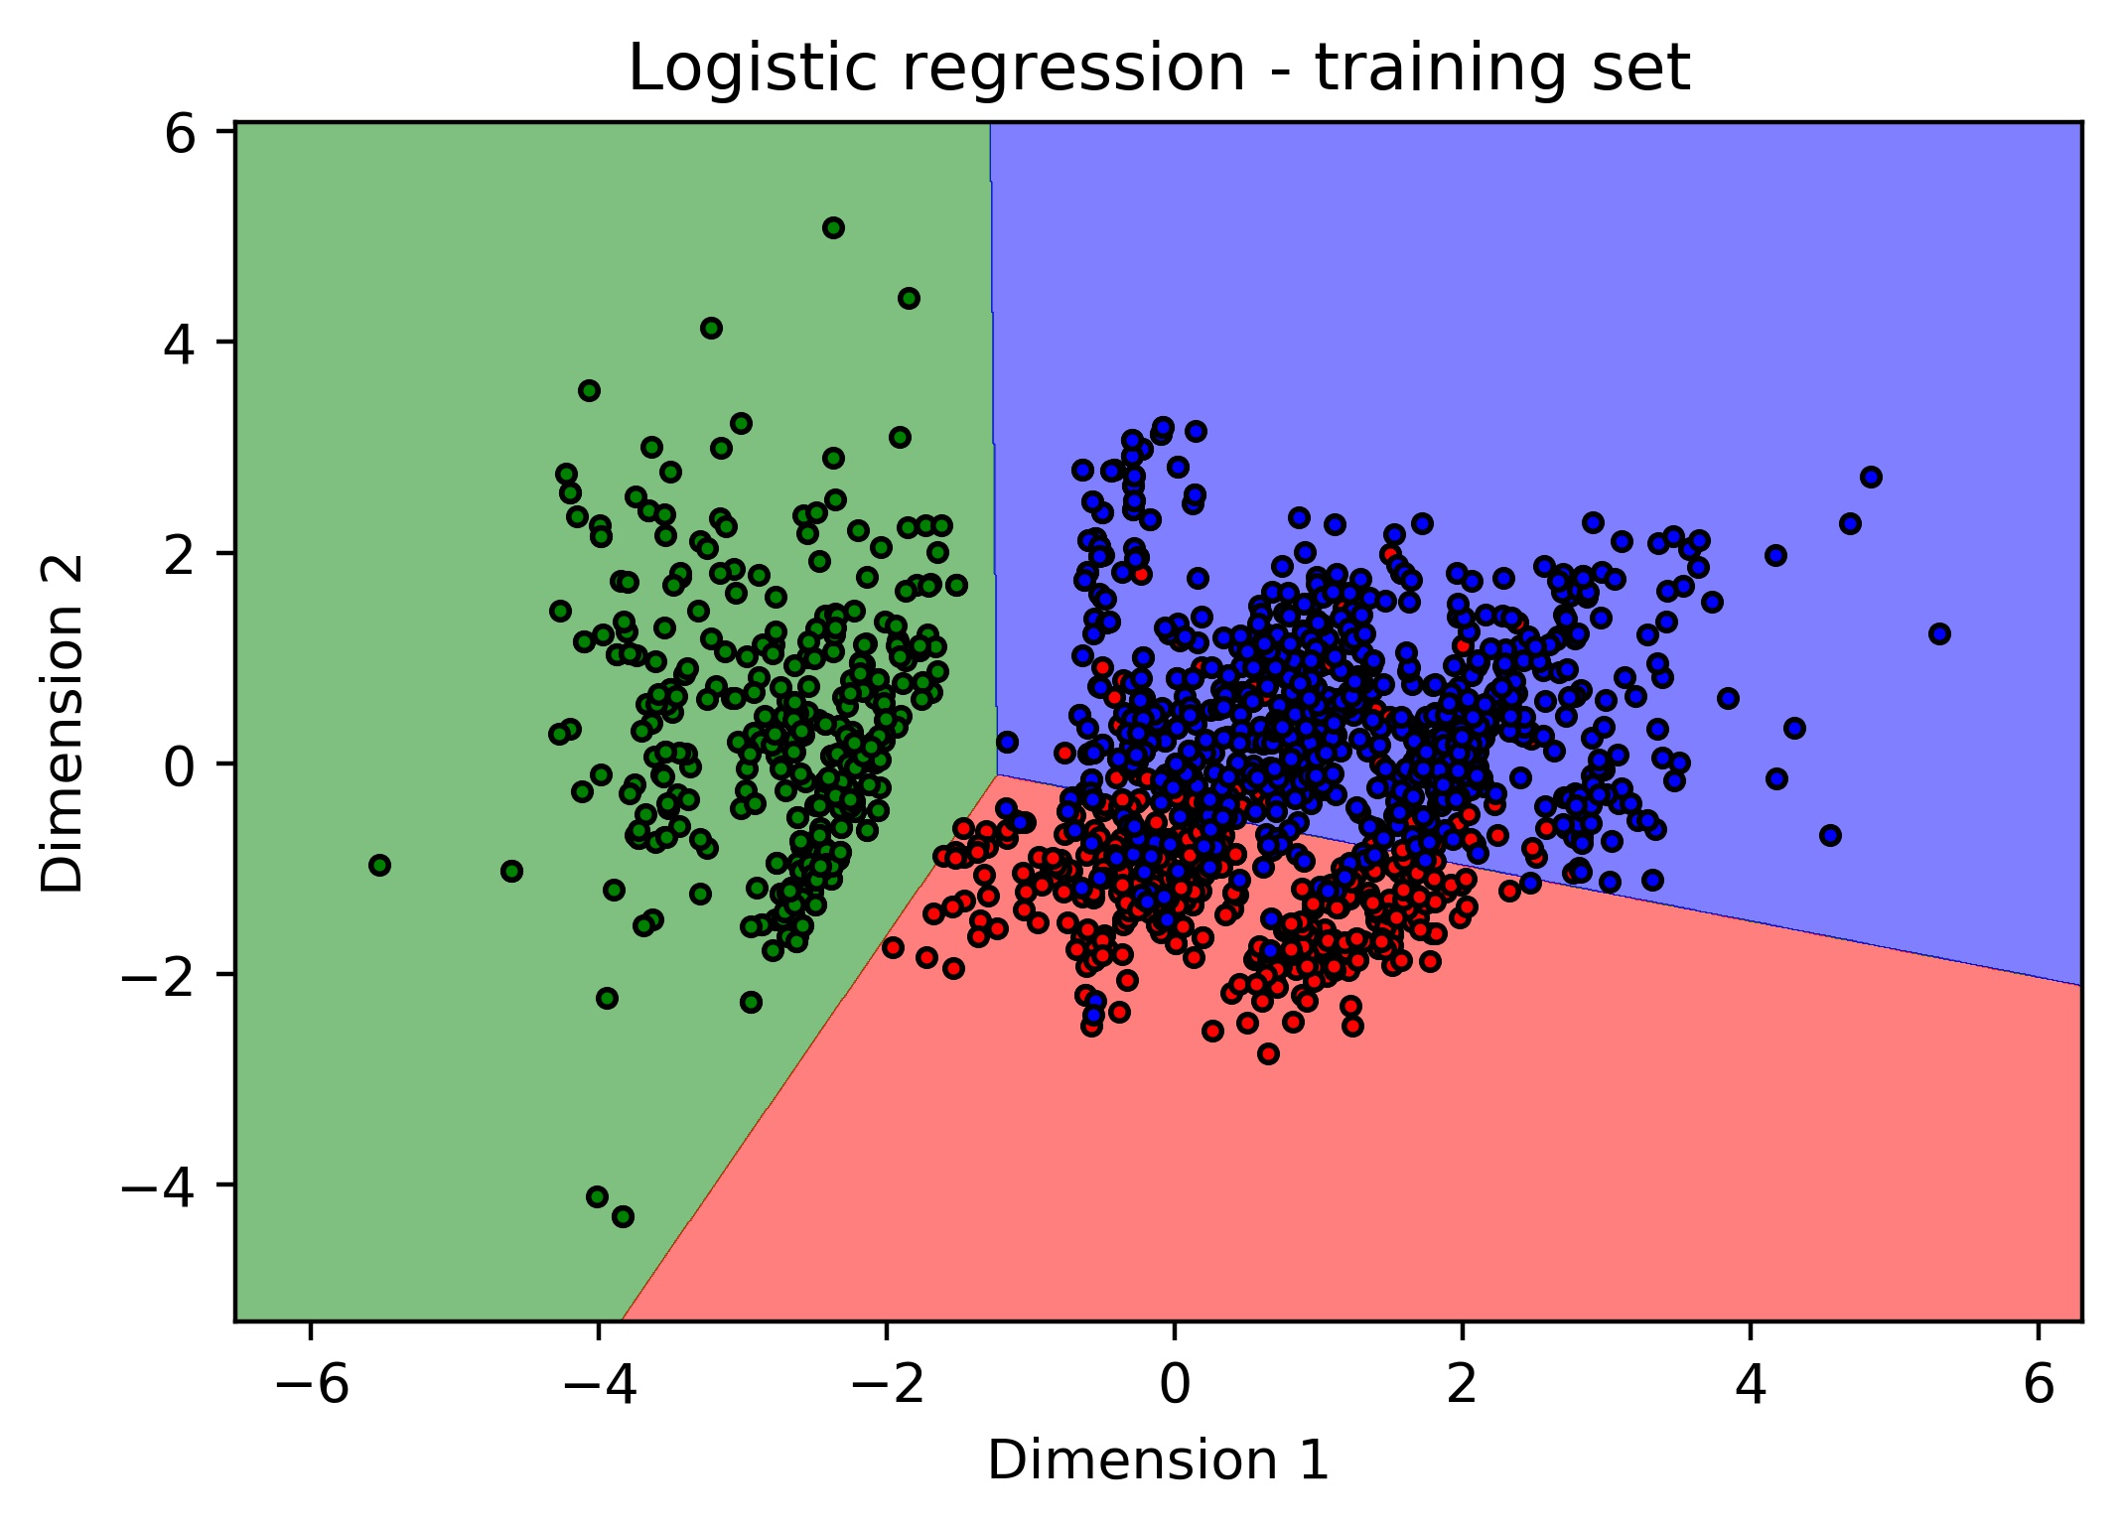
San Francisco
San Jose
Oakland

